Slide 1
Qualitative Data Analysis
Christine Slaughter, Social Science Research Librarian
University of Virginia Library
Adapted from the presentation “Codes to Conclusions” by Lindsay Beyer, UC Berkeley D-Lab

Slide 2
What is “Qualitative Data Analysis”?
“Qualitative data analysis is the classification and interpretation of [textual] material to make statements about [….] structures of meaning-making in the material and what is represented in it.” (Flick 2014) – i.e., how people are making sense of the world

Slide 3
Two major strategies of Qualitative Data Analysis
Reducing complexity/the size of the data (Tactic: coding)
Expanding complexity/the material (Tactic: producing detailed written interpretations of the data)

Slide 4
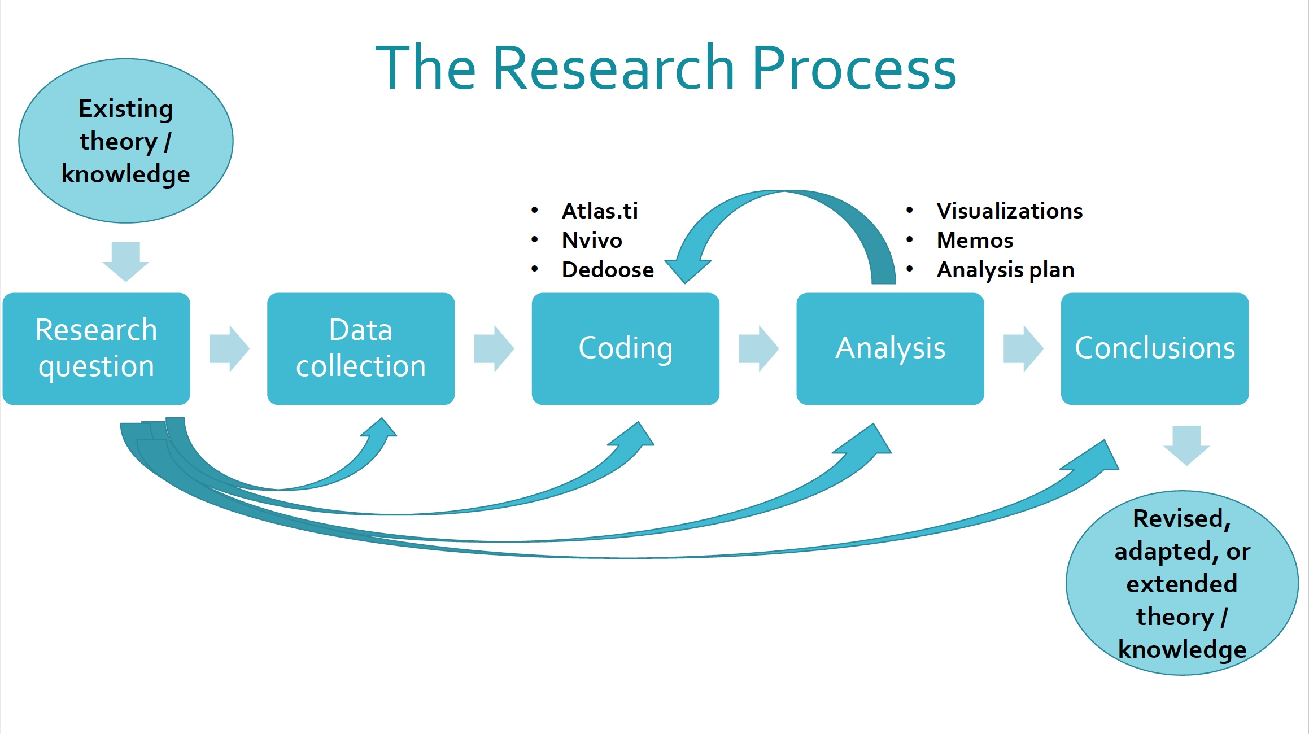

Slide 5
Step 1: Research Question(s)
What are you trying to learn by doing this research?
Research questions can be:
  Deductive – testing a defined hypothesis
  Inductive – discovering new relationships/categories/phenomena or generating new ideas from the data
In both cases, you build upon existing research

Slide 6
Step 1: Research Question(s)
“Lots of people have studied X phenomenon”
  “Fewer people have studied Y aspect of X phenomenon”
    “Almost no one has studied the concept of Z in Y aspect of X phenomenon”

Slide 7
Step 1: Research Question(s)
In some disciplines, you need hypotheses that you can prove or disprove with data
  May be explicit or implicit
  What do you expect to find in your research?
  What have other researchers found?

Slide 8
Step 2: Collect Qualitative Data
Ethnographic field notes
Interview transcripts
Focus group transcripts
Audio or video recordings
Archival data
Open-ended survey data
Meeting transcripts
Organizational documents
Court proceedings
Newspapers
Magazines
Tweets
Other digital data

Slide 9
Step 3: Code Your Data
What is “coding”?
Categorizing and organizing data: breaking it down into analyzable parts
Identifying ideas and concepts in your data that may apply across your different sources
For a particular passage, you can ask:
  What is going on here? (Descriptive)
  What is this an example of? What does this represent? (Analytical)
Can be done manually or with computer software
  NVivo
  Dedoose
  Atlas.ti
  MaxQDA

Slide 10
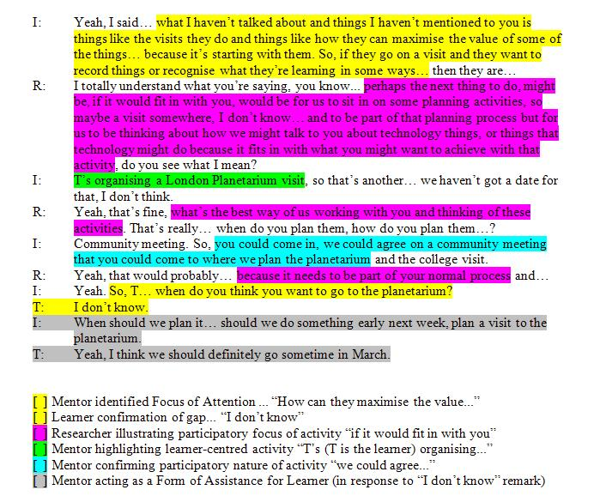
From http://eorframework.pbworks.com/w/page/25026153/001%201-2%20Specify%20Focus%20of%20Attention

Slide 11
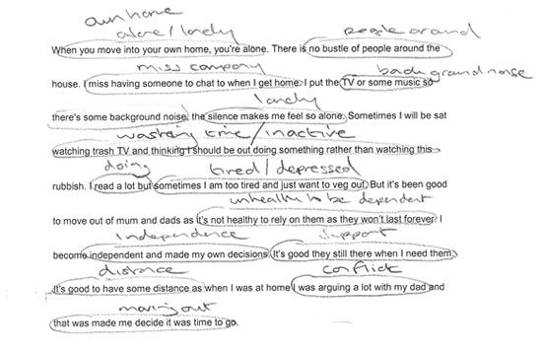
From https://atlasti.com/analysis-software-qualitative-analysis-software/

Slide 12
Step 3: Code Your Data
Codes can be deductive or inductive
  Deductive codes emerge from the literature
  Inductive codes emerge from coding and analysis

Slide 13
Step 3: Code Your Data
Coding is an iterative process
  Start with a list of codes and apply them to a portion of your documents (open coding)
  As you read further, refine and add codes if you think you’re missing any big ideas or themes
    Some codes may be dropped
    Some codes may be separated into two, e.g. “religion” -> “Christianity” and “Islam”
    Some codes may be consolidated, e.g. “soccer,” “cricket” -> “sports”
  You will often move from descriptive to conceptual/theoretical codes as you go
  Keep track of your codes

Slide 14
Step 3: Code Your Data
Open/initial coding
  Compare data with data
  Stay close to and remain open to exploring what you interpret is happening in the data
  Move quickly but carefully through the data (Thornberg and Charmaz 2014)

Slide 15
Step 3: Code Your Data
Questions to ask during open coding (Thornberg and Charmaz 2014):
  What is this data a study of?
  What category does this incident indicate?
  What is actually happening in the data?
  What is the participant's main concern?
  What do the actions and statements in the data take for granted?
  What process(es) is at issue here? How can I define it?
  How does this process develop?
  How does the research participant(s) act and profess to think and feel while involved in this process?
  What might his or her observed behavior indicate?
  When, why, and how does the process change and what are its consequences?

Slide 16
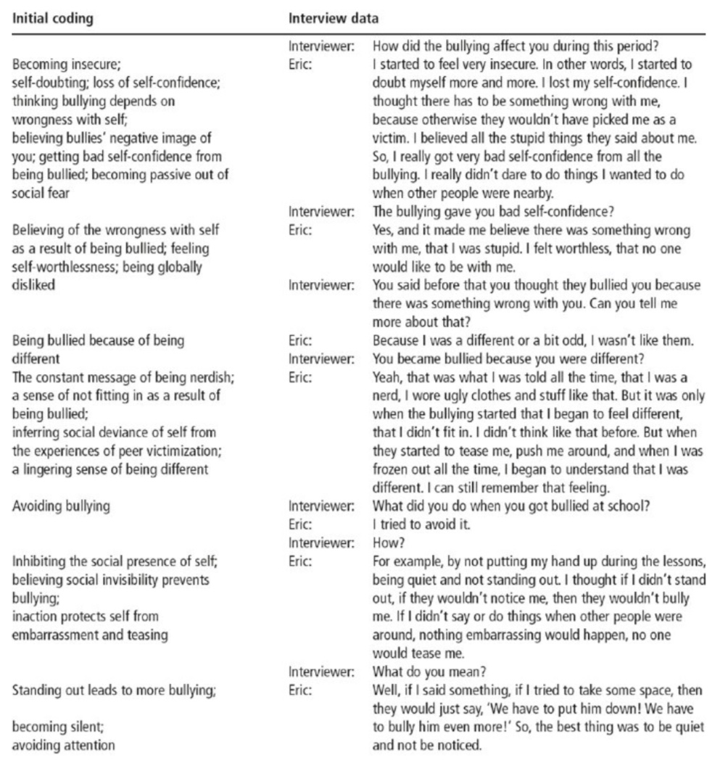
(Thornberg and Charmaz 2014)

Slide 17
Step 3: Code Your Data
Focused/selective coding
  By engaging with your data, you will discover the most frequent or significant initial codes that make the most analytical sense
  These codes, your focused codes, will be used to sift through large amounts of data
  More directed, selective and conceptual than initial codes

Slide 18
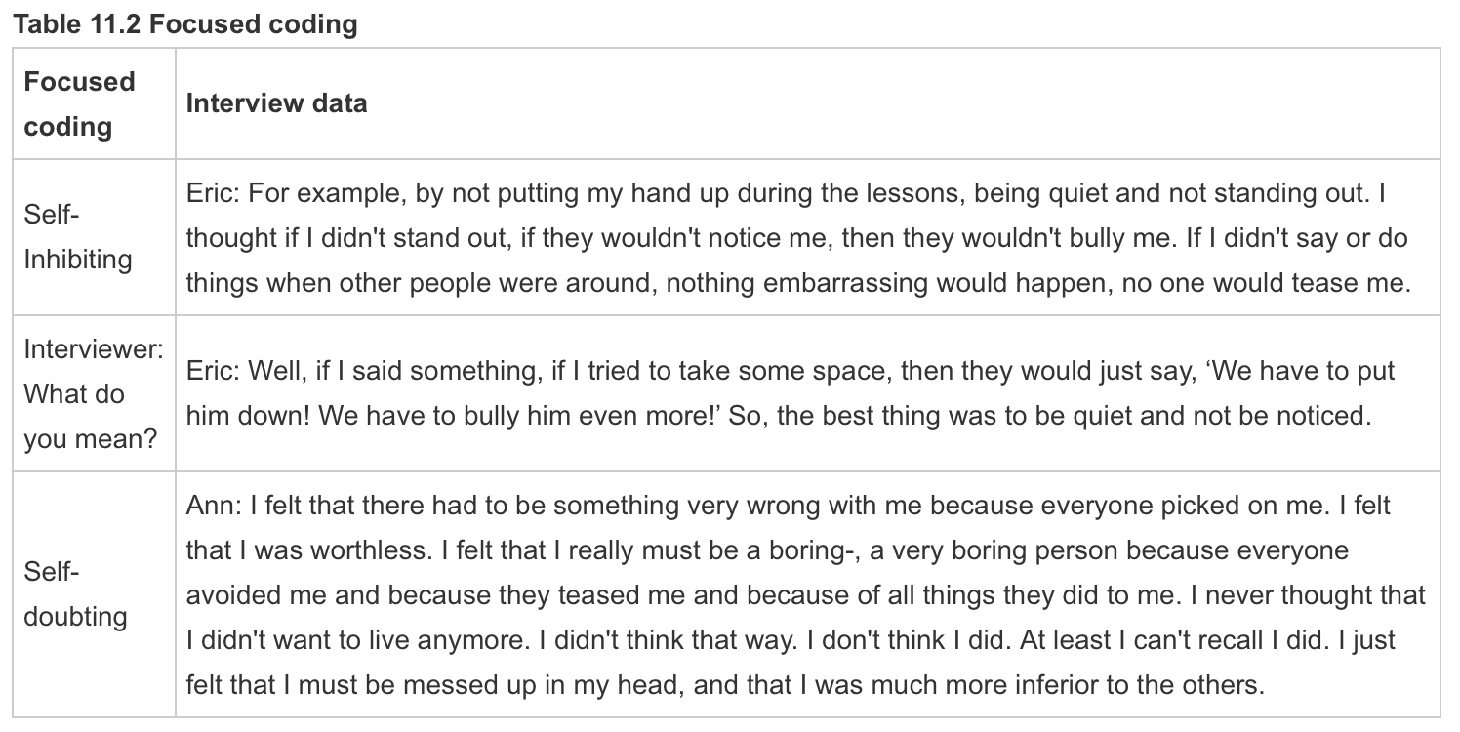
Step 3: Code Your Data
(Thornberg and Charmaz 2014)

Slide 19
Step 3: Code Your Data
Categories
  As you conduct your focused coding, codes will emerge that best capture what you see in the data
  You can raise these codes up to conceptual categories: give them conceptual definitions and assess their relationship to each other [this is the theory emerging from your data-grounded observations]
  These categories can also be thought of as theoretical codes

Slide 20
Step 3: Code Your Data
Generating and refining categories – constant comparative method:
  comparing and grouping codes, and comparing codes with emerging categories
  comparing different incidents (e.g. social situations, actions, social processes, or interaction patterns)
  comparing data from the same or similar phenomenon, action or process in different situations and contexts
  comparing different people (their beliefs, situations, actions, accounts or experiences)
  comparing data from the same individuals at different points in time
  comparing specific data with the criteria for the category
  comparing categories in the analysis with other categories

Slide 21
Step 4: Analyze Your Data
What is “analysis”?
Analyzing means interpreting, synthesizing, and looking for patterns in data in order to draw a conclusion
Which aspects of your data will best answer your research question?
  You will never use all of your data
  Identify which units of analysis, codes, and comparisons or relationships are most important in an analysis plan

Slide 22
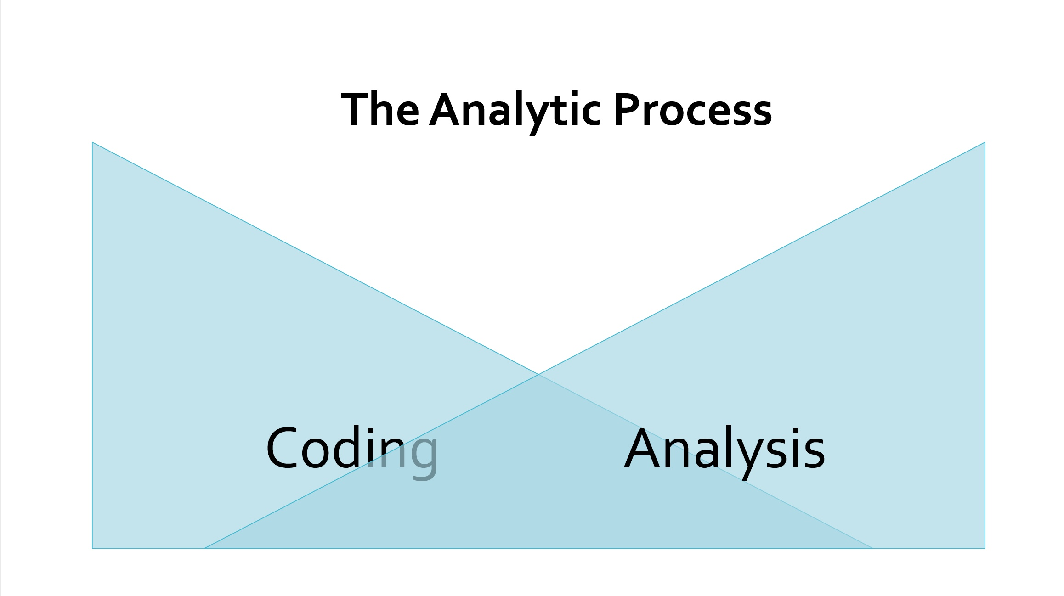

Slide 23
Step 4: Analyze Your Data
What is your unit of analysis?
  Documents
  Individuals
    Includes attributes like age, race, gender, job, attitudes and beliefs
  Organizations
  Locations
  Time Periods
  “Cases”

Slide 24
Step 4: Analyze Your Data
You may have “sub-units”: relevant groupings of data that facilitate comparison and analysis
  Can be both deductive and inductive

Slide 25
Step 4: Analyze Your Data
Sub-groups facilitate comparisons
  Helps you see forces at work in your data
  Look for similarities and differences, and connections between categories
  Which codes and categories frequently co-occur? Which codes and categories never co-occur?
You may look for particular relationships between codes and categories
  Relationships of time (A precedes B)
  Relationships of similarity (A and B both say X)
  Relationships of difference (A says X but B says Y)

Slide 26
Step 4: Analyze Your Data
As you code, write down the thoughts and questions you have about your codes and the relationships between them. These analytic/conceptual notes are called memos.

Slide 27
Step 4: Analyze Your Data
Memos can include:
  working definitions of codes or categories
  comparisons between data and between codes and categories
  identified gaps or vagueness in categories
  hunches, questions, or conjectures to be checked out and further investigated in the empirical research
  fresh ideas and newly created concepts
  comparisons between categories and a range of theoretical codes, and the use of theoretical codes to suggest and investigate possible relations between categories and how categories might be integrated into a modifiable GT
  comparisons with and links to relevant literature (Thornberg and Charmaz 2014)

Slide 28
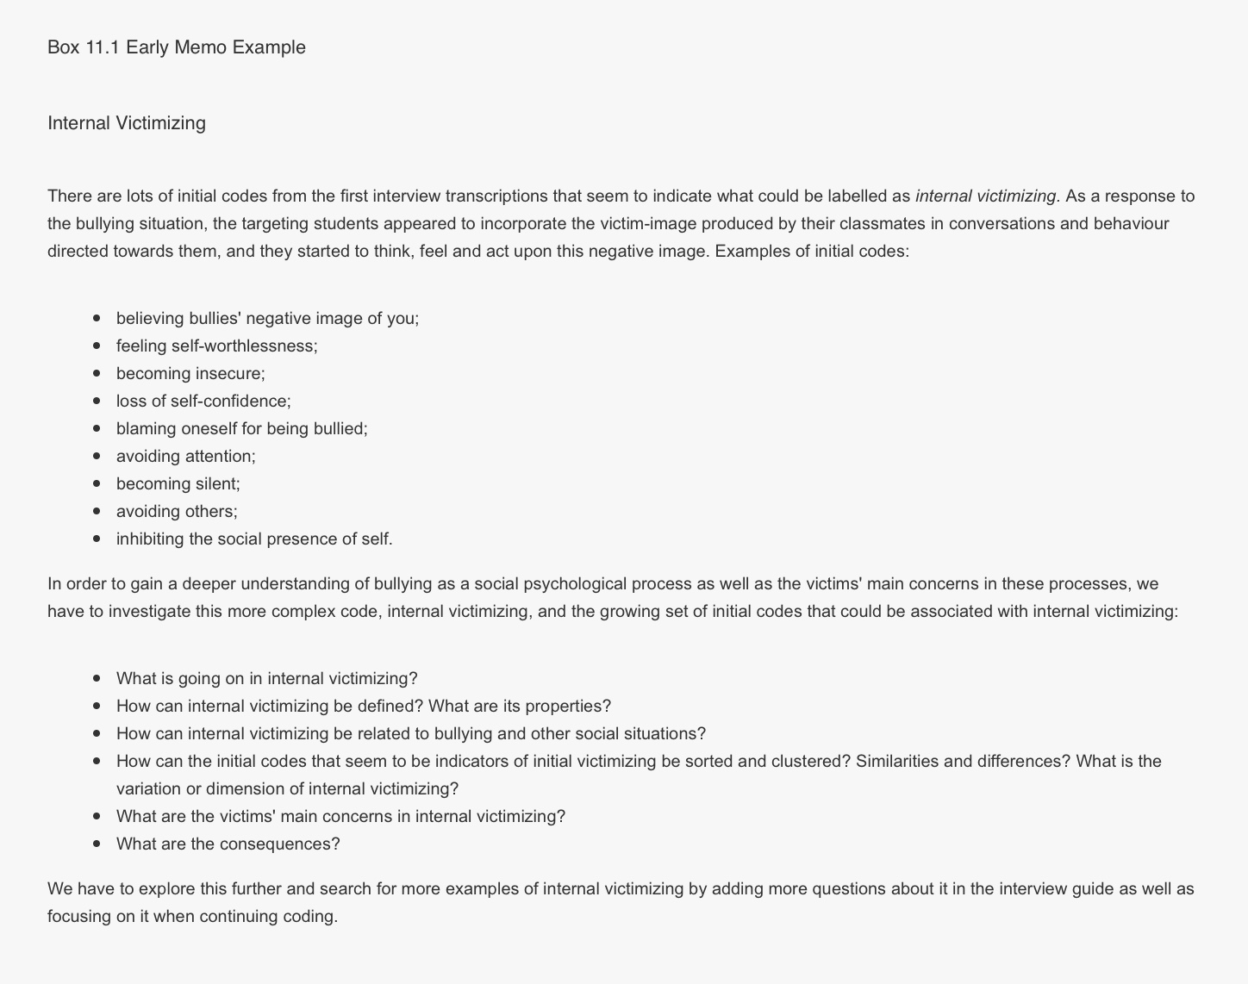
(Thornberg and Charmaz 2014)

Slide 29
Step 4: Analyze Your Data
The further along in the analytic process, the longer, more conceptualized, and more like written findings your memos become
During focused coding, you use memos to raise focused codes into tentative conceptual categories
During theoretical coding, “researchers further compare, sort and integrate their memos. Through memo sorting, they explore, create and refine theoretical relationships.” (Thornberg and Charmaz 2014)

Slide 30
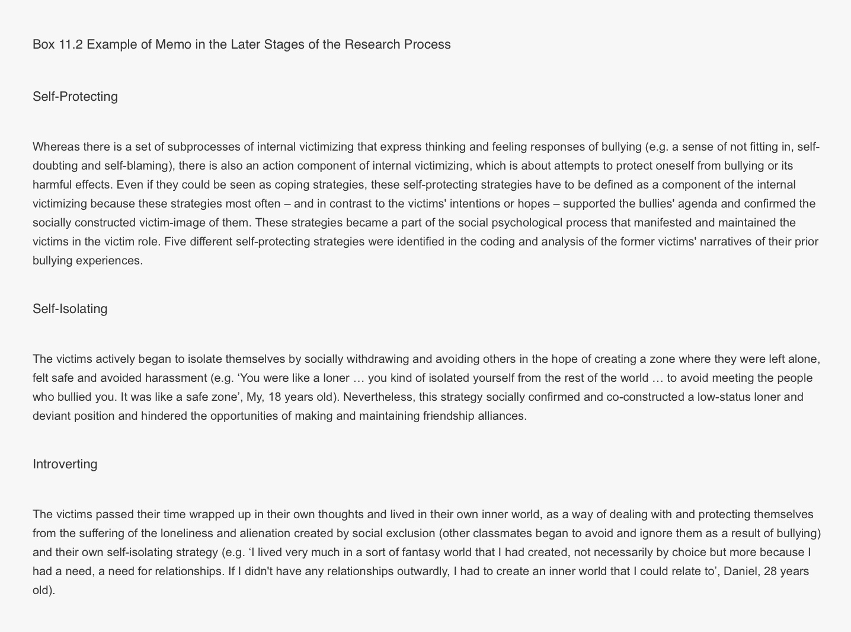
(Thornberg and Charmaz 2014)

Slide 31
Step 4: Analyze Your Data
How do you know when you’re finished?
  A good analytical rule of thumb is when you’ve reached theoretical saturation—that is, when gathering fresh data no longer sparks new theoretical insights, nor reveals new properties of your generated theory and its categories or concepts
  Are there any gaps in your analytic framework or its categories?
  Are there any vague or underdeveloped definitions?
  Are you missing some data?
  Are the findings coherent?

Slide 32
Step 5: Draw Conclusions
What is the “big picture” of your research question, data, and findings?
What kind of story are you trying to tell?

Slide 33
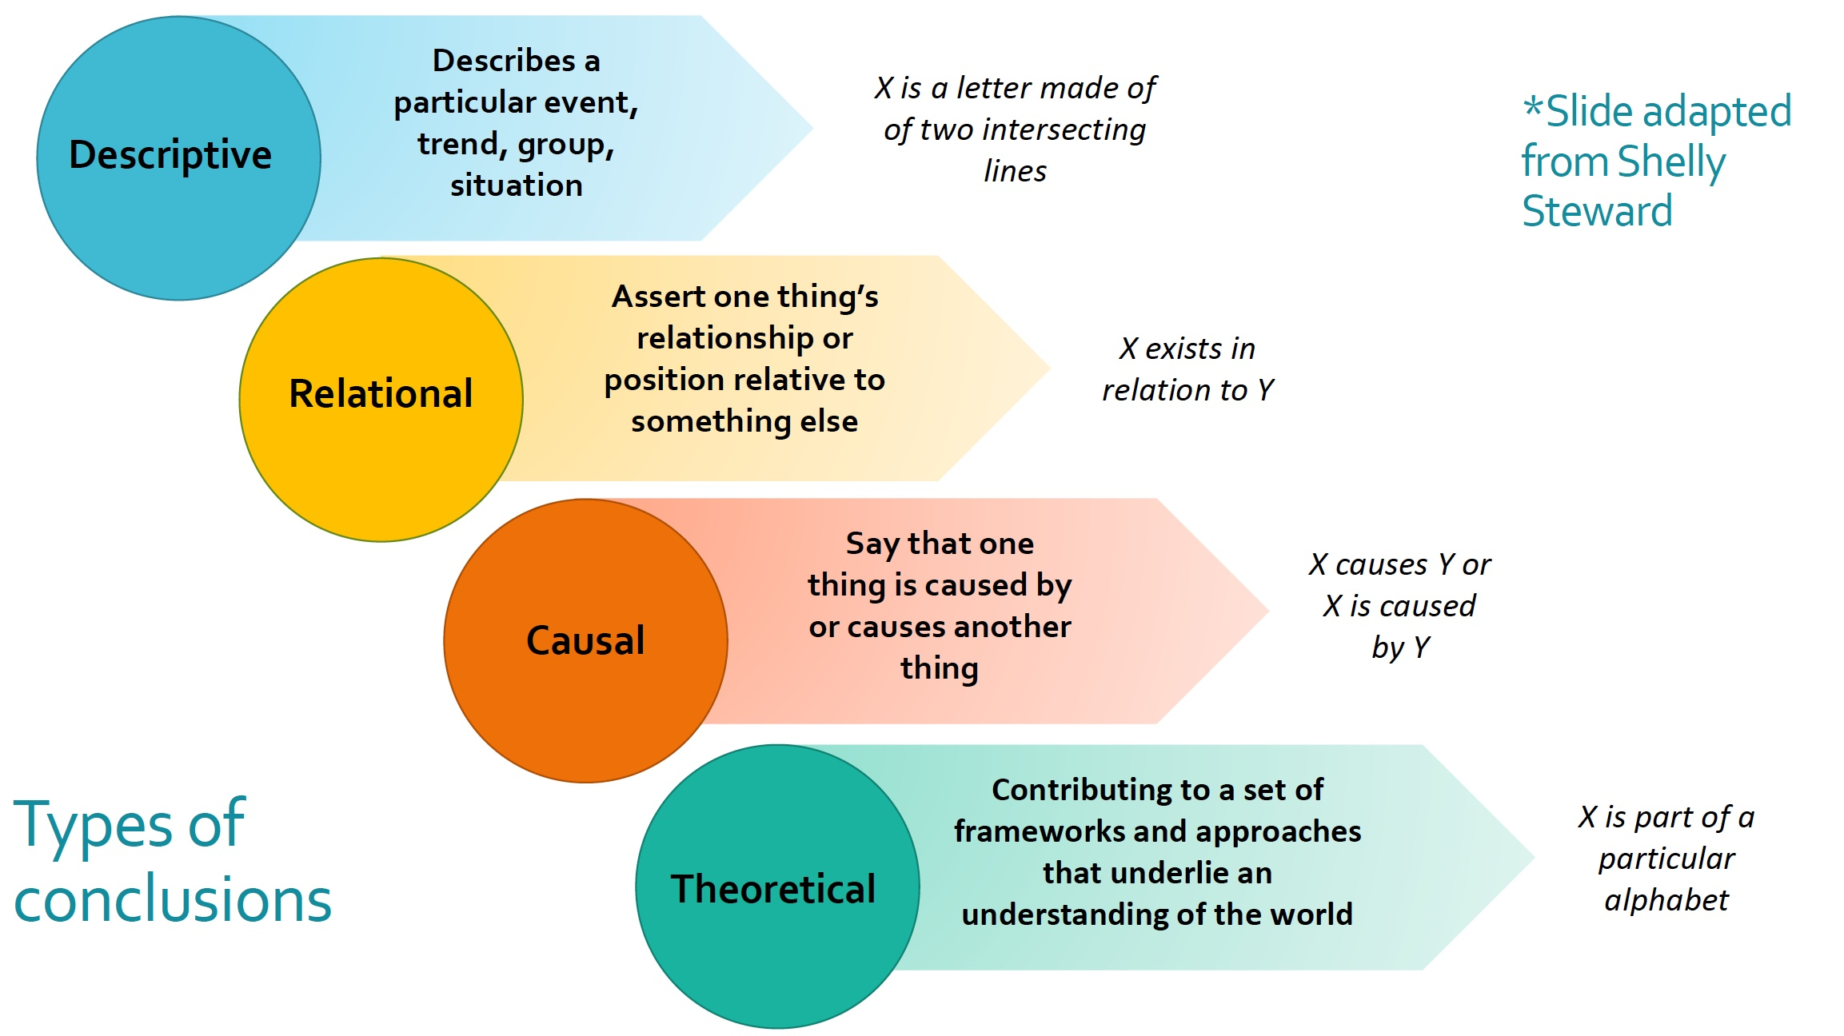

Slide 34
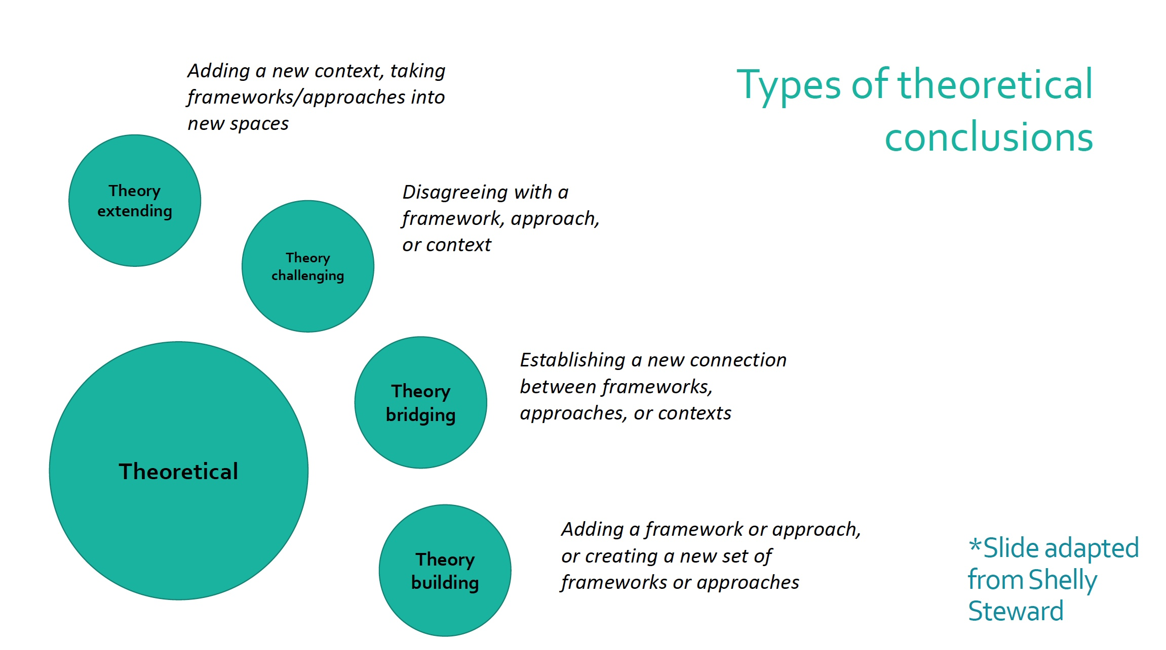

Slide 35
How Do We Evaluate the Quality of Analysis?
How applicable/useful are the findings for policy and practice?
Do the findings inform concepts or themes rather than remain uninterpreted?
Are concepts situated in their contexts and thus allow the reader to understand and evaluate them?
Does the analysis demonstrate a logical flow of ideas or does it contain gaps?
Are the concepts given depth and complexity and show variation in findings through providing rich descriptive details and specifying the links between these concepts?
Does the study offer a creative contribution? (Corbin and Strauss 2008, summarized in Thornberg and Charmaz 2014)

Slide 36
A note on “objectivity”
Don’t think of making your data analysis “objective,” but rather transparent: allow other researchers to see how you reached your conclusions
Some journals now request or require that researchers submit examples of coded documents to indicate how they interpreted their data

Slide 37
Works cited
Beyer, Lindsay. 2008. “From Codes to Conclusions: Analyzing Qualitative Data.” Accessed 20 October 2018. http://dlab.berkeley.edu/sites/default/files/training_materials/From%20Codes%20to%20Conclusions--May%202018.pdf.
Flick, Uwe. 2014. “Mapping the Field.” In The SAGE Handbook of Qualitative Data Analysis, ed. Uwe Flick. Accessed 22 October 2018. doi: http://dx.doi.org/10.4135/9781446282243.n1.
Thornberg, Robert and Kathy Charmaz. 2014. “Grounded Theory and Theoretical Coding.” In The SAGE Handbook of Qualitative Data Analysis, ed. Uwe Flick. Accessed 23 October 2018. doi: http://dx.doi.org/10.4135/9781446282243.n11.

Slide 38
On to Dedoose!
www.dedoose.com
We will be using the files from the Dropbox folder sent to you in yesterday’s email

Slide 39
Thank you
Contact me: christine.slaughter@virginia.edu

